Slide 1
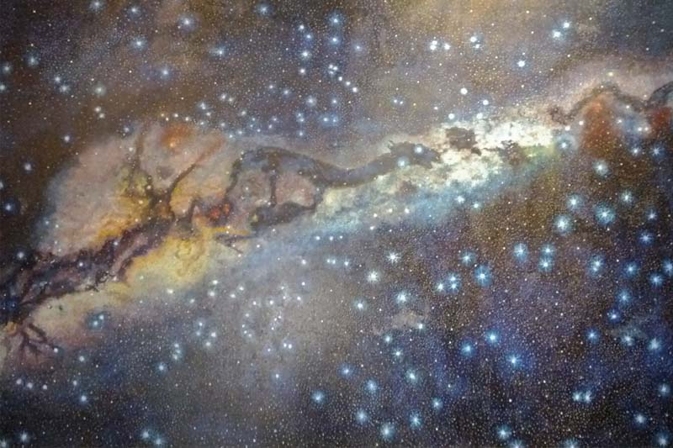



ASTROBIOLOGY AND SETI IN PERU:
RECENT AND FUTURE ADVANCES
Grupo de Astronomía – SPACE
Facultad de Ciencias Físicas
Universidad Nacional Mayor de San Marcos
Authors: P. Musso , T. Vargas, V. Vera, I. Meza,
C. Maccone, and N. Antonietti.

Slide 2

CONTENTS
I. HISTORY AND PROJECTS
II. HABITABLE ISLANDS IN THE UNIVERSE

Slide 3
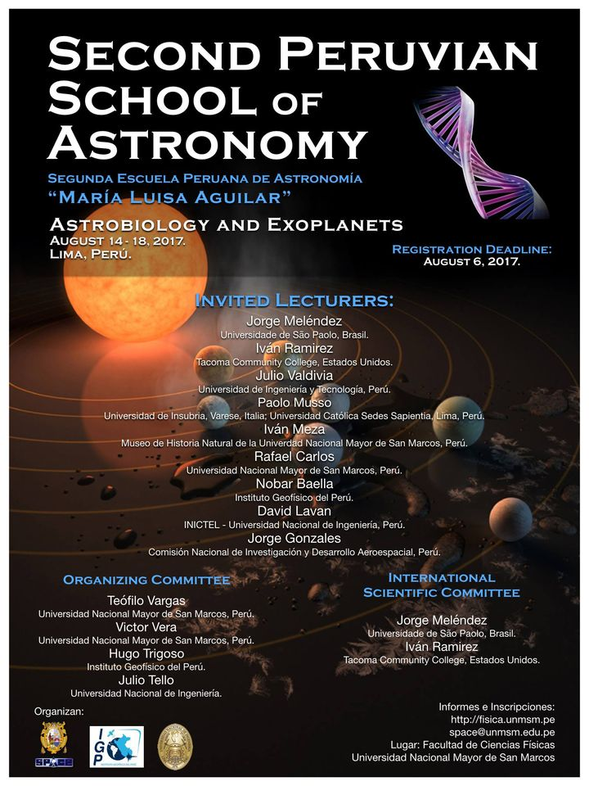
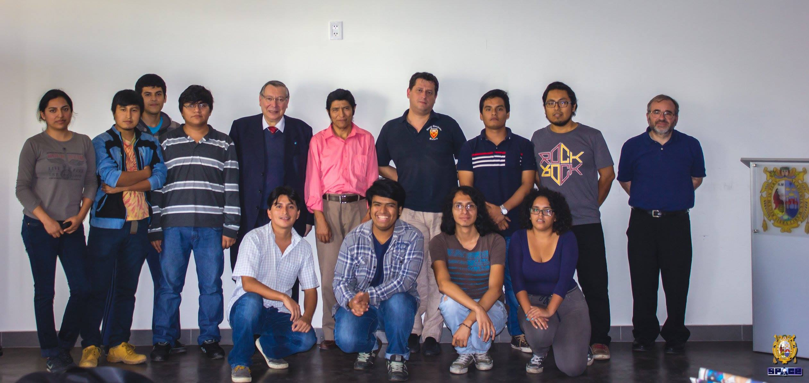
History: formation of the group
In April 2017 professors C. Maccone, J. G. Funes, P. Musso and other astronomers
visited our university and our astronomy group.
This visit was a spark to form the astrobiology group and
then organize a school dedicated to astrobiology and
series of seminars on the subject.

Slide 4

History: Peruvian SETI group
d
Since 2020 we are member of IAA SETI and after the Covid pandemic,
we are now resuming our project, which moves along three main
lines:
The astronomical observatory of San Marcos National University in Cusco was
recently inaugurated and our main objective is to present a project to the
Peruvian funding scientific institution (CONCYTEC) for the acquisition of a
medium-sized optical telescope to be part of a global network of modest-sized
Optical SETI observatories.
This effort will be carried out in collaboration with the InCosmiCon research
center at the University of Insubria in Italy.
This project (if successful) will allow the modest-sized Optical SETI access to the
sky of the southern hemisphere.
- Astrobiology and SETI in Peru. Recent and future advances

Slide 5
2) The application for the creation of the first Peruvian School of
Astronomy and Space Science at the San Marcos National University
in Lima, has already been submitted to the dean of our department.
Astrobiology and SETI will be one of the main programs of the school.
The procedure for approving the new school takes approximately 2 years,
therefore, by 2025 the school would be in operation.
3) Carrying out a series of studies about some crucial topics of Astrobiology and
SETI, like the extension of the galactic habitable zone, the encoding of
advanced mathematics in interstellar messages, and the ongoing experience of
intercultural dialogue at the Amazonian University UCSS-Nopoki of Atalaya as a
possible model for interstellar communication.
This program will be carried out in collaboration with the InCosmiCon research
center.
In the next few slides, we will present the recent advances already made and
those expected in the future along point 3.

Slide 6
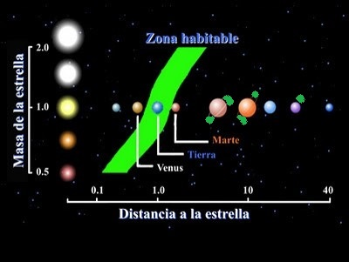
II. Habitable Islands in the universe
Stellar Habitable Island-SHI
Stellar Habitable Zone (SHZ) marks the range of distances at which an orbiting
planet receives enough heat from its star to host liquid water on its surface.
Water or another liquid is generally considered a necessary ingredient for life to
arise and survive, so SHZ represent convenient boundaries within which to
search for life beyond our solar system.
On the other hand, it is well known that
moons of solar system planets outside
of a SHZ contains liquid water.
Extraterrestrial liquid water:
Enceladus, Triton, Dione, Pluto, Europa,
Callisto, Titan and Ganymede.

Slide 7
The detection of exoplanets has undergone extraordinary growth over the past
couple of decades since the classical works: HD 114762 (Latham et al 1989),
pulsars (Wolszczan & Frail 1992), and 51 Peg (Mayor & Queloz 1995), and up to
this point nearly 5,514 have been discovered.
Only a small proportion of these are likely to be able to sustain life, existing in
what is known as the SHZ.
On the other hand, some planets, especially large gas giants, may harbour moons
which contain liquid water.
These moons can be internally heated by the gravitational pull of the planet they
orbit, which can lead to them having liquid water well outside the normal
narrow of SHZ.
Such possibility is the moons orbiting the exoplanet J1407b (Sutton, MNRAS 2019).

Slide 8
Furthermore, according to recent research by (Lingam & Loeb, ApJL 2020),
external heating from starlight is not the only way to keep a planet warm
enough for surface liquids.
They investigate the conditions under which worlds outside the SHZ are capable
of supporting liquid solvents on their surface over geologically significant
timescales via combined radioactive decay and primordial heat from the
planet’s formation.
Their analysis suggests that:
super-Earths with radionuclide abundances that are thousand times higher
than Earth can host long-lived water oceans.
Based on these observations we introduce the concept of Stellar Habitable
Islands (SHI), referring to the location of stellar exoplanets or exomoons
outside the habitable zone that is more favorable for the development of life.

Slide 9
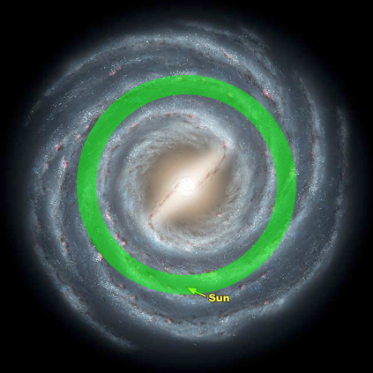
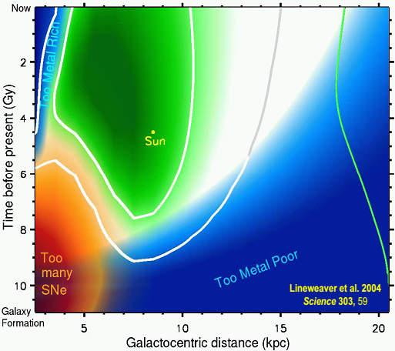
Galactic Habitable Islands-GHI
The concept of Galactic Habitable Zone (GHZ) , i.e. an environment free from life-
extinguishing supernovae, with a high enough metallicity for Earth-sized planet
formation, star formation and sufficient time for the evolution of complex life,
is crucial for the search for life in the universe, since it substantially reduces the
enormous number of planets potentially hosting life, (Maroshnik & Mukhin
1986 ; Balazs 1988; Gonzalez et al. 2001; Lineweaver et al. 2004).

Slide 10
(Lineweaver et al. 2004) suggested that the current zone occupies an annular
region between 7 and 9 kpc from the Galactic center that widens with time.
On the other hand, (Prantzos 2008) countered that the uncertainties are such
that the contours of such a zone cannot be even approximately defined,
neither in space nor in time, and suggested that the entire Galactic disk may
be suitable for life.
Furthermore, (Gowanlock et al. 2011) suggested that the majority of planets
currently capable of supporting complex life may be towards the inner Galaxy,
distributed not only near, but also significantly above and below the Galactic
plane, where the supernova rate is lower.
Also (Balbi et al. 2020) evaluated the rate of SN explosions in the bulge and
found that, although much higher than in the disk, it is not likely to result in
the complete eradication of life on inhabited planets.

Slide 11
According to (Buchhave et al. 2012), the formation of small, terrestrial planets
does not require a metal-rich environment, suggesting that their existence
might be widespread in the disk of the Galaxy outside the GHZ.
Thus, recent observations has shown that not only near the galactic center there
are zones safe enough for life to evolve, but also in the outer part of the Milky
Way there could be some zones with a high enough metallicity to generate
habitable planets.
These results implies that the morphology of the GHZ is not longer a toroidal
region as in Lineweaver et al., but consists of disconnected regions with a
higher density of habitable zones at a distance of 8 kpc from the galactic center
but also with isolated habitable zones near to the Galactic center, and outskirts
of the galaxy.

Slide 12
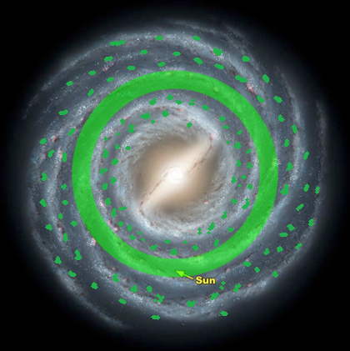
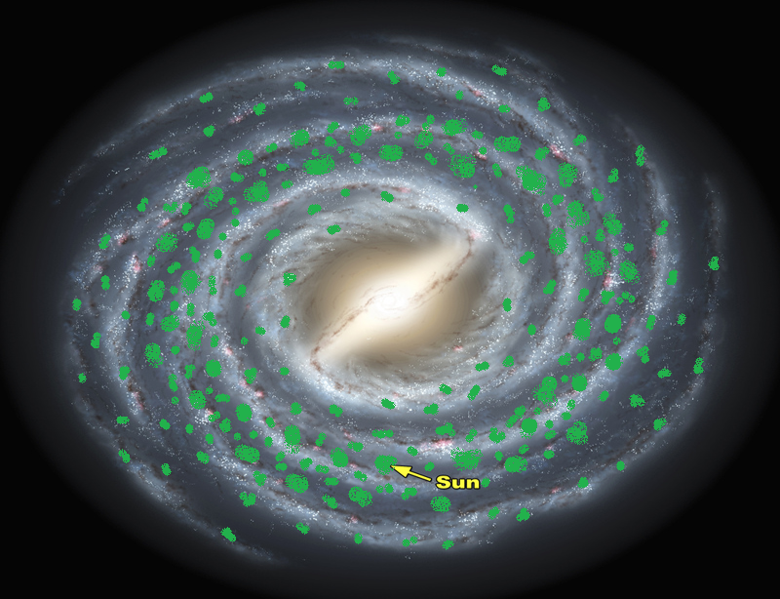
Based on these observations we introduce the concept of Galactic Habitable
Islands (GHI), referring to the location of zones safe enough for life to evolve
near the center and in the outer part of the galaxy.
For GHI some numerical simulations for a very limited model of radial
symmetry of Milky Way has been done in (Vargas et al. 2021, 2022).

Slide 13
From the cosmological point of view, (Piran et al. 2016) have shown that the
cosmological constant plays a crucial role at creating habitable regions for
galaxies in a habitable epoch.
They showed that in dense environments, there are many explosions, and the
safe zone is to be in the outskirts, or in regions that have not been highly
populated by small galaxies and that’s exactly where the Milky Way is.
Also (Dayal et al. 2015) showed that metal-rich, shapeless giant elliptical galaxies
at least twice as massive as the MW can potentially host ten thousand times as
many habitable (Earth-like) planets, making them the most probable cradles of
life in the universe.
Bringing together these cosmological considerations on habitable zones, the
Stellar Habitable Islands (SHI) and the Galactic Habitable Islands (GHI), we
introduce a concept of Cosmic Habitable Islands (CHI), referring to the location
in our Universe that is most favourable to the development of life.

Slide 14
Conclusion
We introduced the idea of Stellar and Galactic Habitable Islands together with
the Habitable Islands in the Universe because, due to various underlying
factors, life-supporting habitable zones are not distributed
uniformly throughout space and time in our universe.
These concepts of Habitable Islands may have little or no significance at all.
It should be considered, at best, as a broad framework, allowing us to formulate
our thoughts and knowledge about a very complex phenomenon such as
Life on exoplanets, in galaxy and the universe.
The motivation for our work is to investigate how, and to what extent, the
consideration of these Habitable Islands can assist in developing effective
strategies for the search for extraterrestrial intelligence (SETI), not only in the
neighborhood of our galaxy but in the entire universe from a complementary
and integrated perspective.

Slide 15

This talk incorporates results from some research
projects supported by the InCosmiCon Research
Center at the University of Insubria (Italy)

